Slide 1



Projeto_Accenture_01 - Databricks
View in Power BI
Last data refresh:
13/03/2021 17:07:47 E. South America Standard Time
Downloaded at:
13/03/2021 17:12:22 E. South America Standard Time

Slide 2
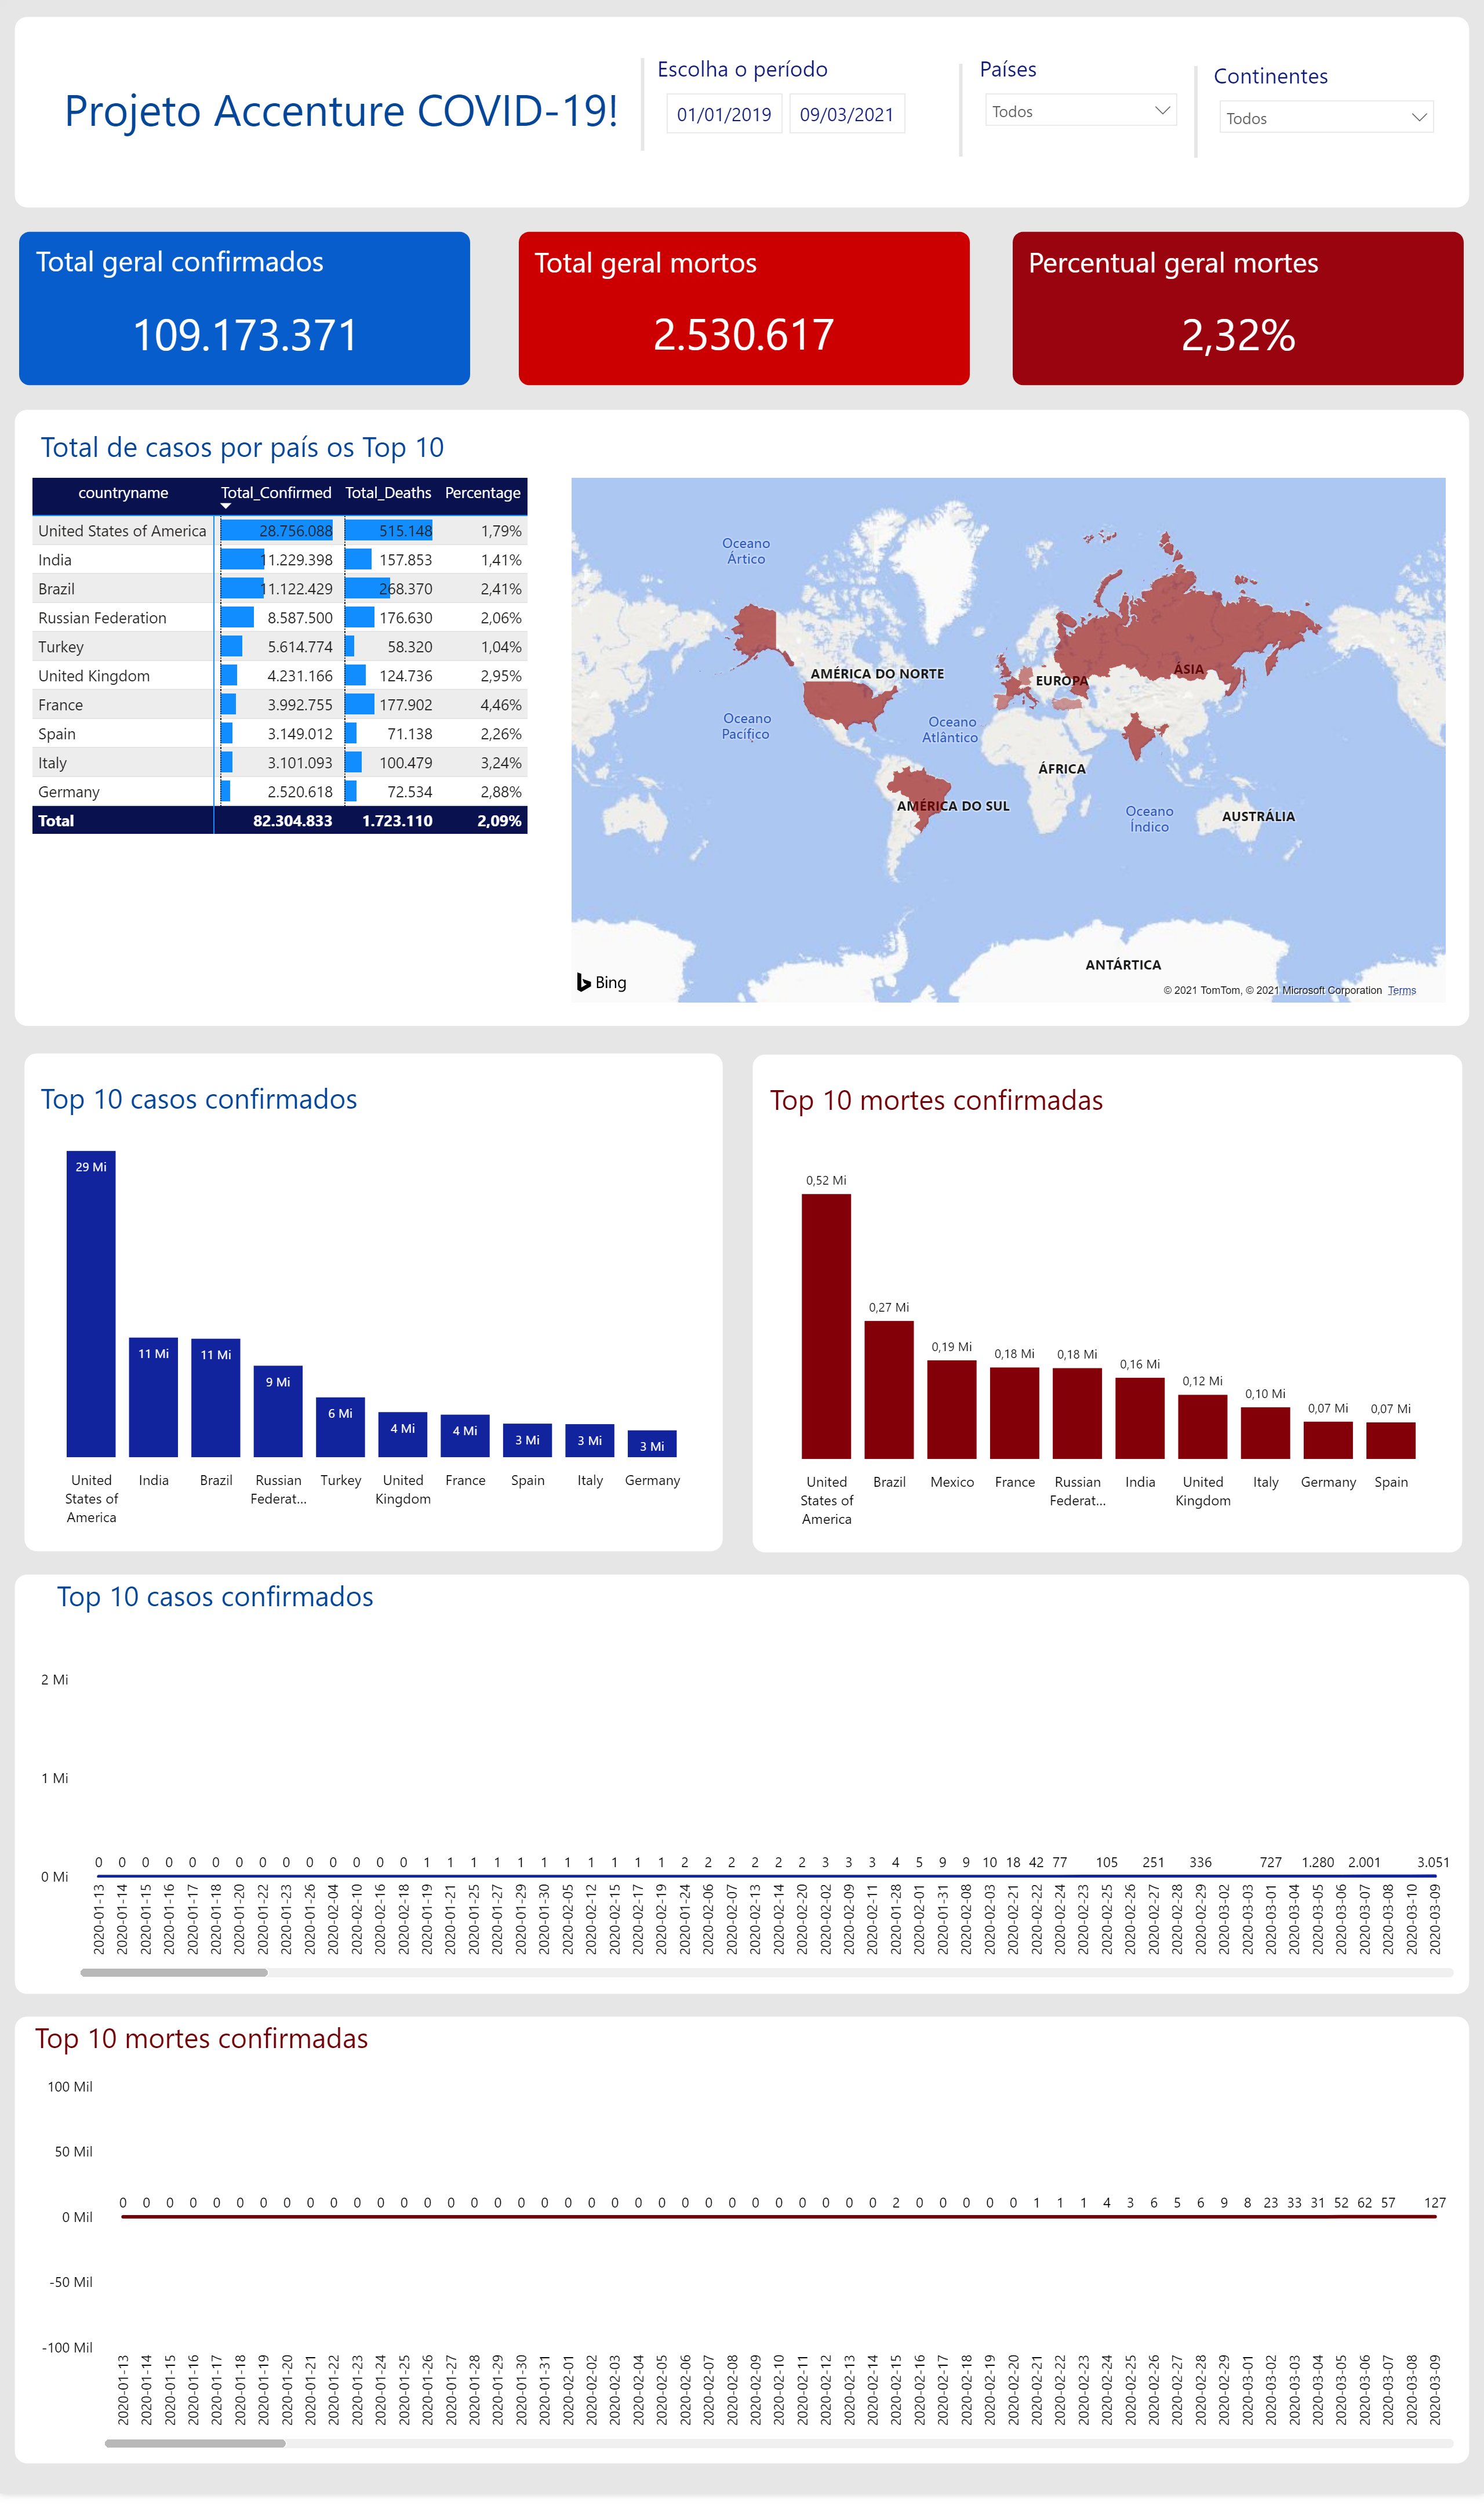
Covid_19

